Slide 1
https://codeburst.io/algorithms-i-searching-and-sorting-algorithms-56497dbaef20

Slide 2
CSS143 Computer Programming (II)

Slide 3
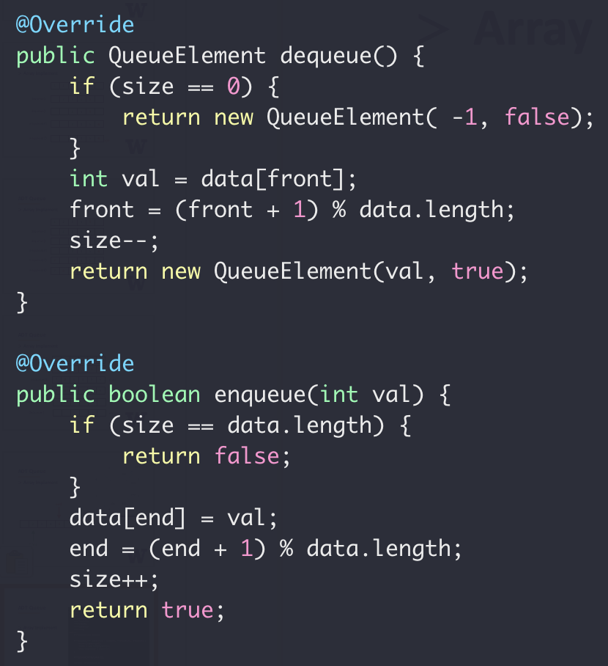
ADT Queue
Array Implement

Slide 4

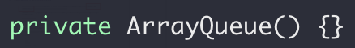
ADT Queue
disable default constructor

Slide 5
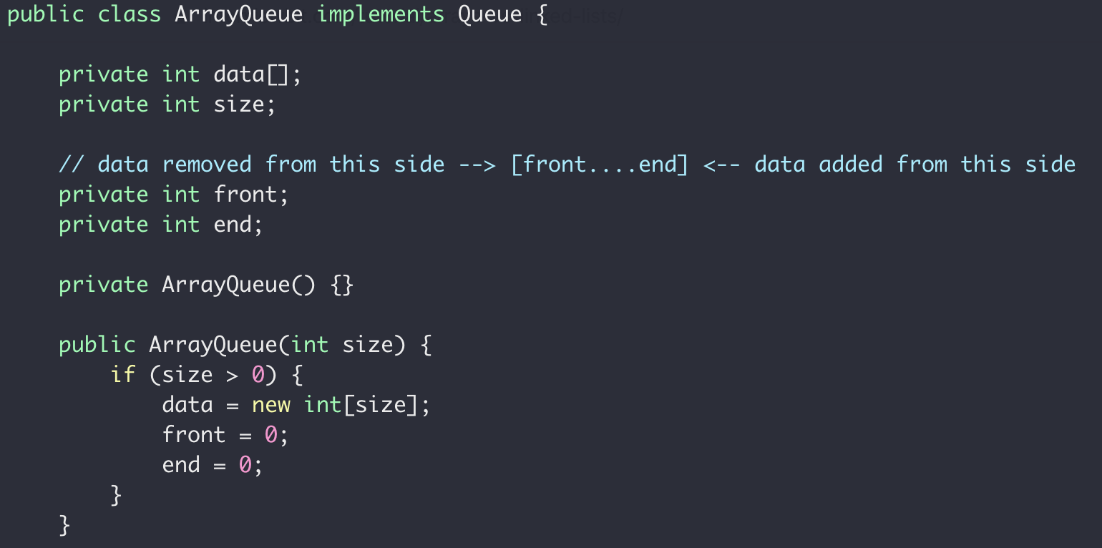
ADT Queue

Slide 6
ADT Queue
Remove the limitation of queue size
Option 1: Better/smarter Algorithm
Option 1: Better/smarter Algorithm
Option 2: Different data structure

Slide 7


Array vs List
12
12
1
7
18
10
3
0
1
2
3
4
5
6
Bookshelf

Slide 8
Array → List
12
12
1
7
18
10
3
head
12
12
12
1
7
18
10
3
value
“Node”
reference

Slide 9
Array vs List
0
12
1
8
2
3
4
7
0
5
10
1
12
6
head
2
12
0
7
3
12
1
8
4
1
4
9
5
7
18
10
6
18
11
14
7
10
12
3
8
3
13
null
9
14
10
10
15
12
array
list
16

Slide 10
Array vs List
Array:
Contiguous in memory
Fast random access
Fixed size
12
12
1
7
18
10
3
head
12
12
1
7
18
10
3
null
LinkedList:
Random addressed in memory
No random access
Size not fixed
More comparison between array and linked list

Slide 11
Single Linked List vs Double Linked List
head
12
12
1
7
18
10
3
Single/Singly Linked List
null
head
12
12
1
7
18
10
3
null
null
Double/Doubly Linked List

Slide 12
Linked List
“interface”
head
12
12
1
7
18
10
3
null
add(value) : Add a node in the end addFirst(value) : Add a node in the beginning
removeFirst() : Remove a node from the beginning removeLast() : Remove a node from the end
getFirst() : Return the first node getLast() : Return the last node
size() : Size of the list

Slide 13
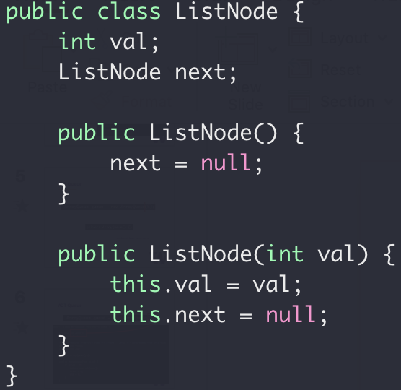
Linked List
“Implementation”
Next
Next
Next
Next
end
“Node”
value
reference

Slide 14
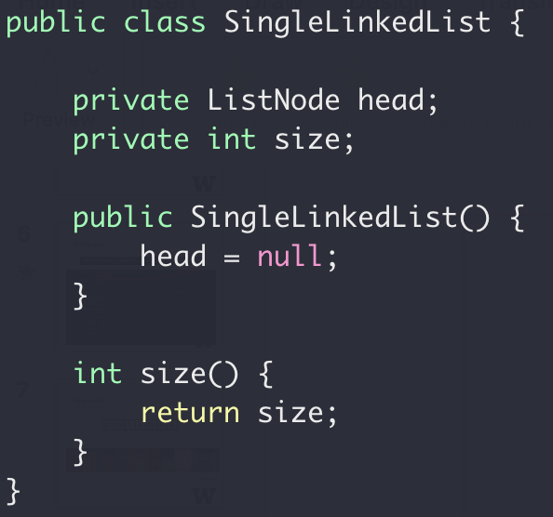
Single Linked List
“Implementation”
Next
Next
Next
Next
end

Slide 15
Single Linked List
Now let’s fill in the funcitons:
add(value) : Add a node in the end addFirst(value) : Add a node in the beginning
removeFirst() : Remove a node from the beginning removeLast() : Remove a node from the end
getFirst() : Return the first node getLast() : Return the last node
size() : Size of the list

Slide 16
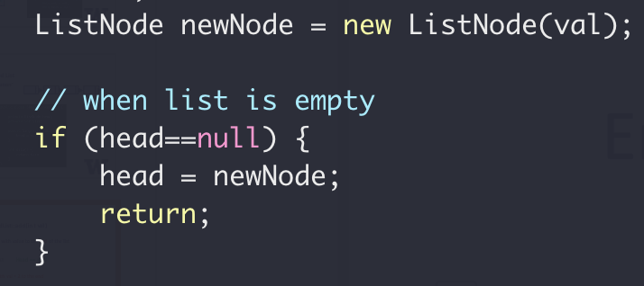
SingleLinkedList::add(int val)
Add a node with value to the end of the list
Empty List
Head == null
Add a node with val = 2 to the end
val = 2
Head
null
Next

Slide 17
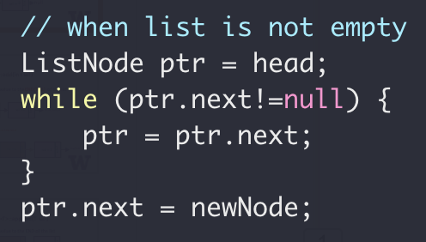
SingleLinkedList::add(int val)
Add a node with value to the end of the list
val = 2
head
null
Next
Add a node with val = 3 to the end
val = 2
val = 3
head
Next
null
Next
null

Slide 18
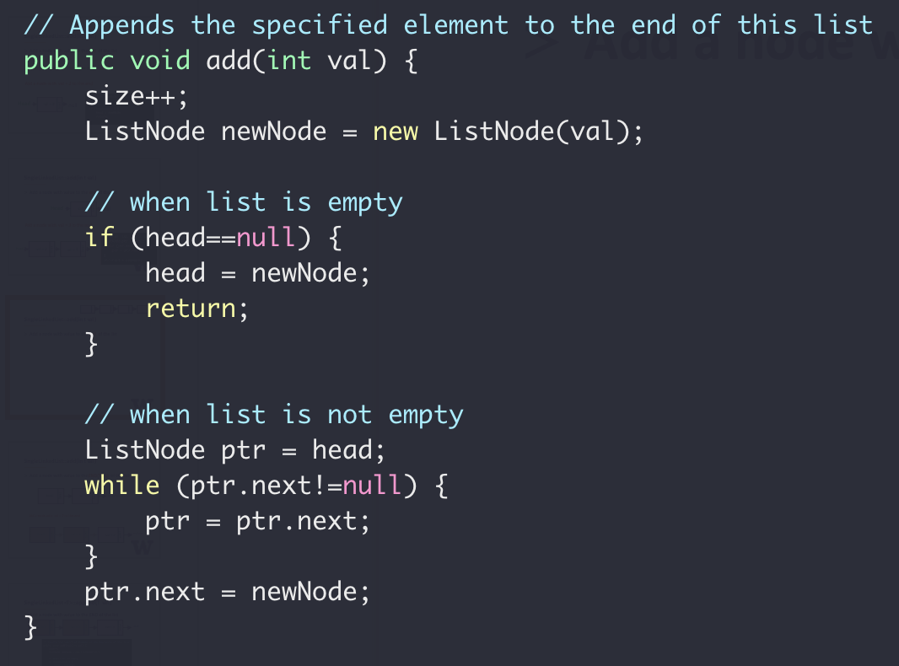
SingleLinkedList::add(int val)
Next
Next
Next
Next
end
Add a node with value to the end of the list

Slide 19

SingleLinkedList::addFirst(int val)
Add a node to the beginning of the list
val = 2
val = 3
head
null
null
Next
Next
val = 1
Next

Slide 20
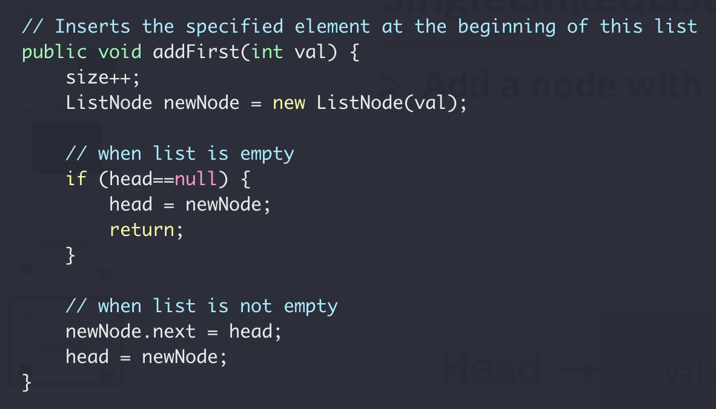
SingleLinkedList::addFirst(int val)
head
Next
Next
Next
Next
end
Add a node to the beginning of the list

Slide 21
SingleLinkedList::removeFirst(int val)
Remove the first node of the list
val = 2
val = 3
head
null
null
Next
Next

Slide 22
SingleLinkedList::removeFirst(int val)
Remove the first node of the list
Empty List
head == null
None-empty List
head
val = 2
val = 3
null
null
Next
Next

Slide 23
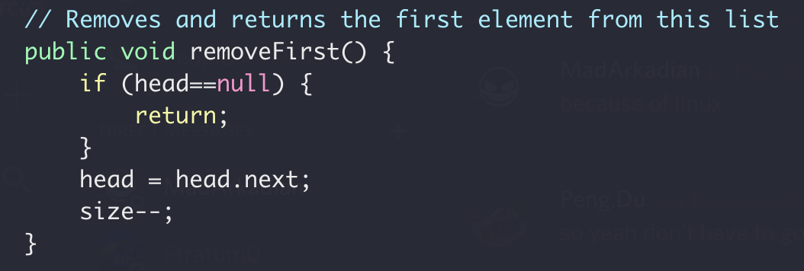
SingleLinkedList::removeFirst(int val)
Remove the first node of the list

Slide 24
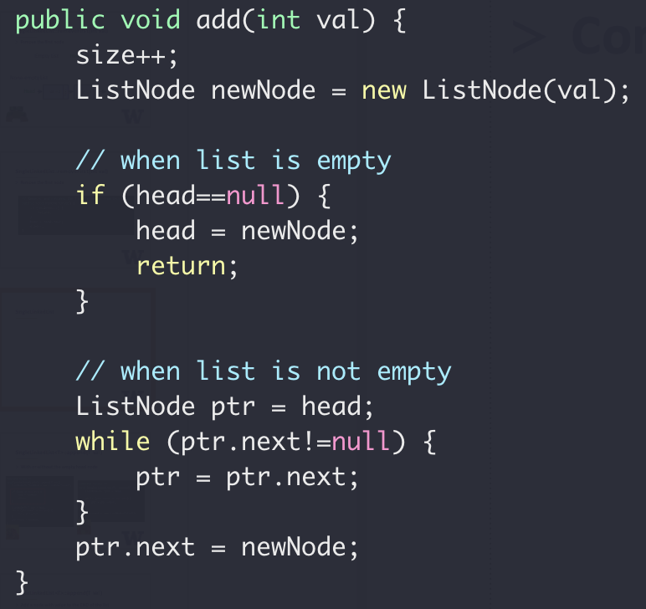
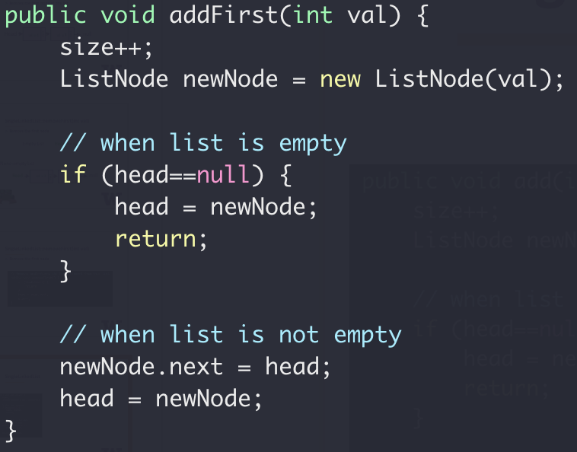
SingleLinkedList
head
end
Next
Next
Next
Next
Special case for empty list

Slide 25
SingleLinkedList
Sentry/dummy node
head
val = 2
val = 3
null
null
Next
Next
val = 2
val = 3
head
Next
null
null
Next
Next
Sentry/dummy node
Always exists since list creation
Value is not used

Slide 26
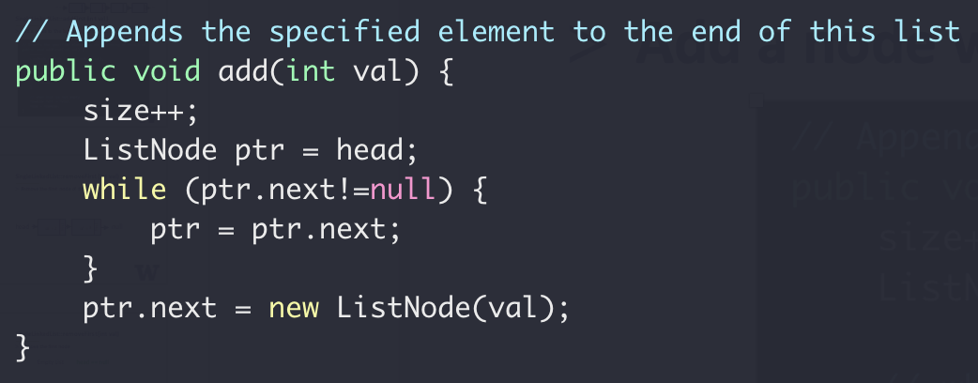
SingleLinkedList::add(int val)
Add a node with value to the end of the list
With sentry node

Slide 27
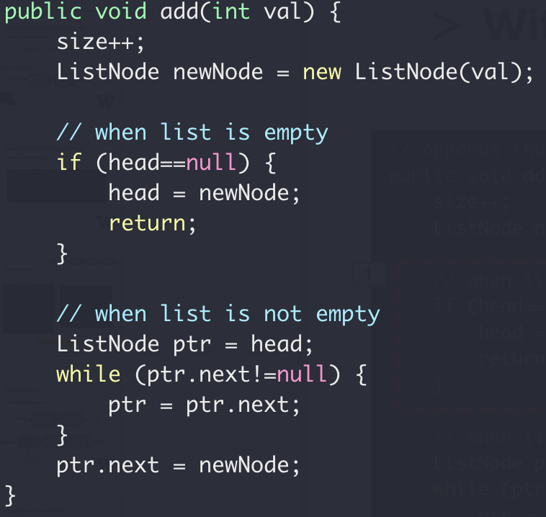
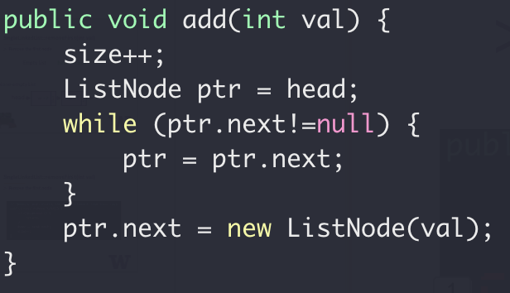


SingleLinkedList::add(int val)
Add a node with value to the end of the list
With sentry node

Slide 28
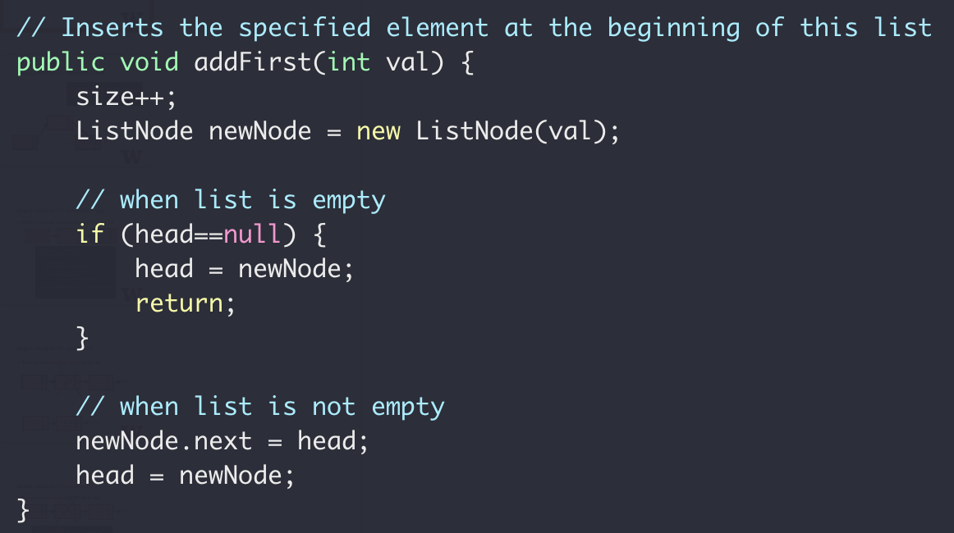
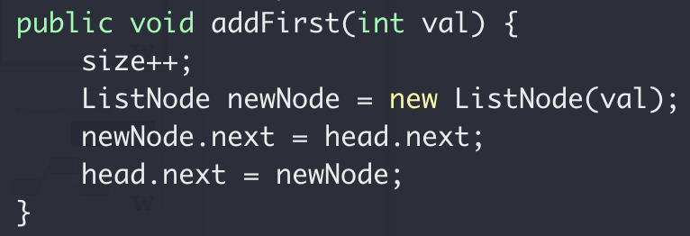
SingleLinkedList::addFirst(int val)
Add a node to the beginning of the list

Slide 29
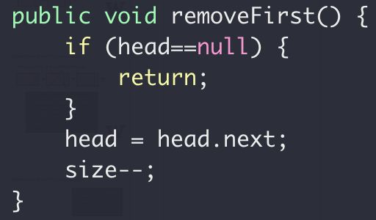
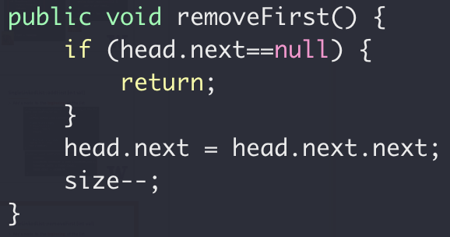
SingleLinkedList::removeFirst(int val)
Remove the first node of the list

Slide 30
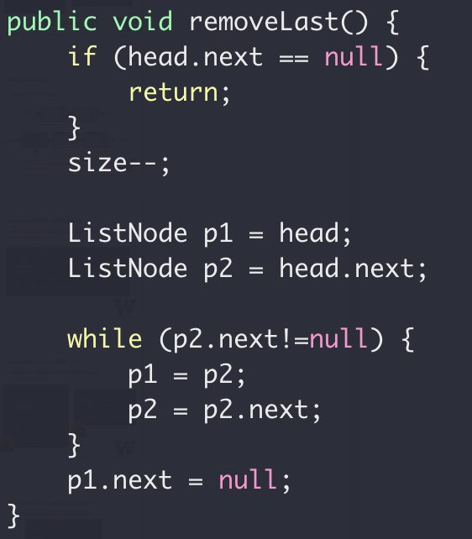
SingleLinkedList::removeLast()
Use sentry node
?
h → 2 → 5 → N
p1
p2

Slide 31
SingleLinkedList::removeLast()
Use sentry node
h → 2 → 5 → N
h → 2 → N
p1
p2

Slide 32
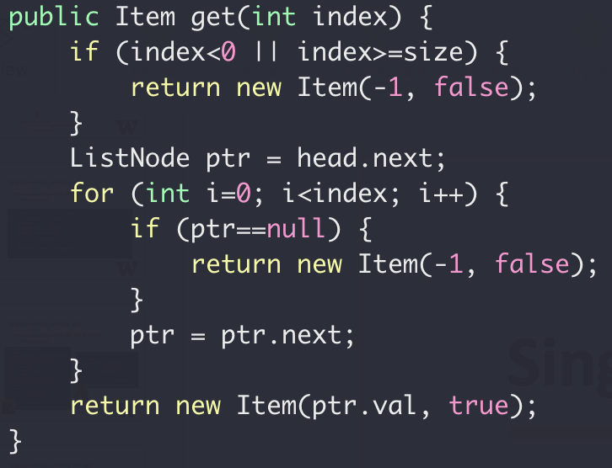
SingleLinkedList::get(int index)
Returns the element at the specified position in this list
Use sentry node
?
get(0) returns {2, true}
get(1) returns {5, true}
get(3) returns {-1, false}
h → 2 → 5 → 1 → N
p1

Slide 33
SingleLinkedList::get(int index)
Returns the element at the specified position in this list
h → 2 → 5 → 1 → N
How many stops to get list[2]?
For an array instead, how many stops to get array[2]?

Slide 34
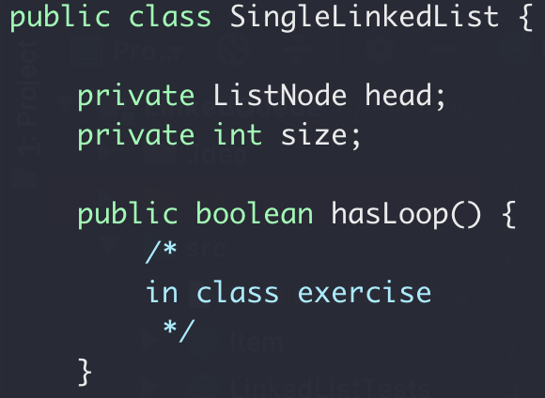
Linked List in-class lab 2
Given the head pointer (assuming dummy head node)
Find whether the list has a loop

Slide 35

Linked List in-class lab 2
Given the head pointer (assuming dummy head node)
Find whether the list has a loop
Head → 0 → 1 → 2 → 3 → 4 → 5
8
7
6

Slide 36
Linked List in-class lab 2
Find whether the list has a loop
p0
p0
p0
p0
p1
head → 0 → 1 → 2 → 3 → 4 → 5
p1
p1
8
7
6
p1

Slide 37
ADT Queue
Remove the limitation of queue size
Option 1: Better/smarter Algorithm
Option 1: Better/smarter Algorithm
Option 2: Different data structure

Slide 38
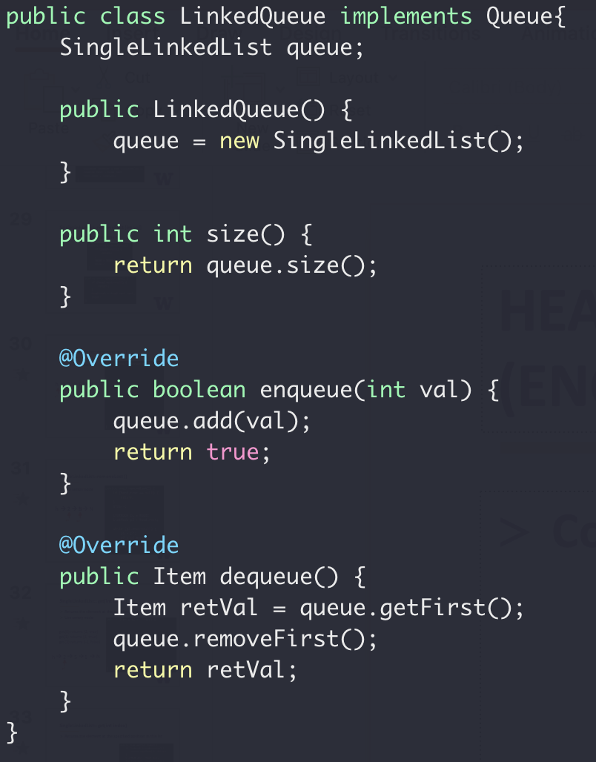
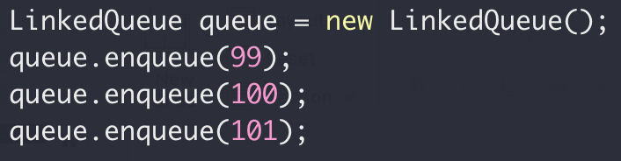
Queue with Linked List

Slide 39
ADT Queue
ADT Queue
Interface
enqueue()
dequeue()
size()
Implementation
Public Access
Linked List
Array

Slide 40
ADT Queue

